Slide 1
Part-time jobs to full-time careers. Empowering Nebraskans to achieve economic independence and thrive in work and life in partnership with employers.
WIOA Title I financially assisted programs and activities are equal opportunity employer programs. Auxiliary aids and services are available upon request to individuals with disabilities.

Slide 2
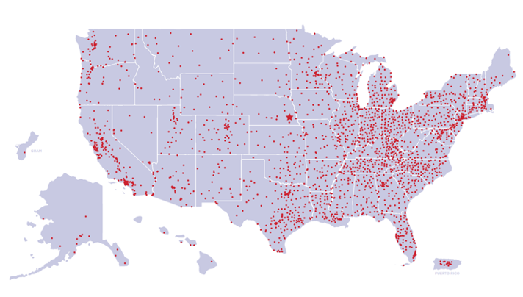
Our American Job Center
is part of a network
of nearly 2,300 centers.

Slide 3
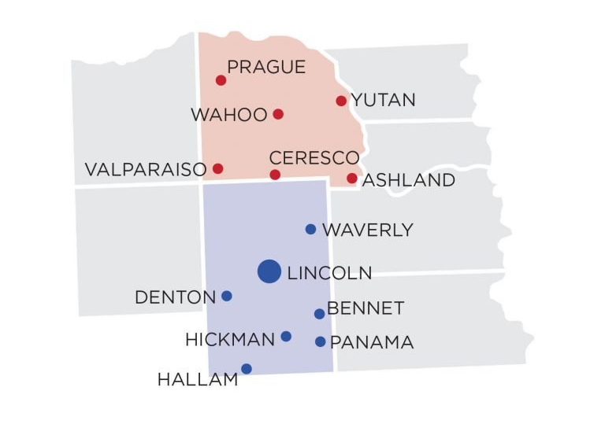
Service Area
We serve Lancaster and Saunders counties. This includes the Star City (Lincoln), Wahoo, Ashland, and the Bohemian Alps. If you live in or want to work in one of these counties, we can help you find a job. If you are an employer doing business in our service area, we can assist.

Slide 4
All American Job Center services
are provided at no cost.

Slide 5
Job-seeker services

Slide 7
We help job seekers.
If you want to get back to work,
find a better job, change careers,
or enter the workforce for the first time,
we can help.

Slide 8
We help individuals gain
high-quality jobs with livable wages,
strong benefits, and opportunities to
build a career.

Slide 9
Our services encompass the entire
job spectrum, including support for
work-related needs. Resume creation.
Filing for unemployment. Training for
a new career. Transportation.
Childcare. Uniforms. And much more!

Slide 10
Services for:
55 + Worker
Adults
Credential Seeker
Entrepreneurs
Indian & Native Americans
Laid Off Worker
Migrant & Seasonal Farm Worker
Military & Veterans
Workers with a Criminal Conviction
Workers with Disabilities
Young Adults & Youth
Under Employed

Slide 11
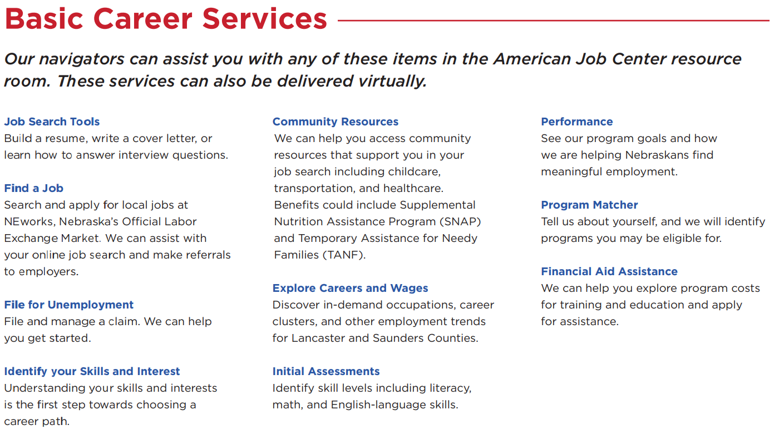

Slide 14
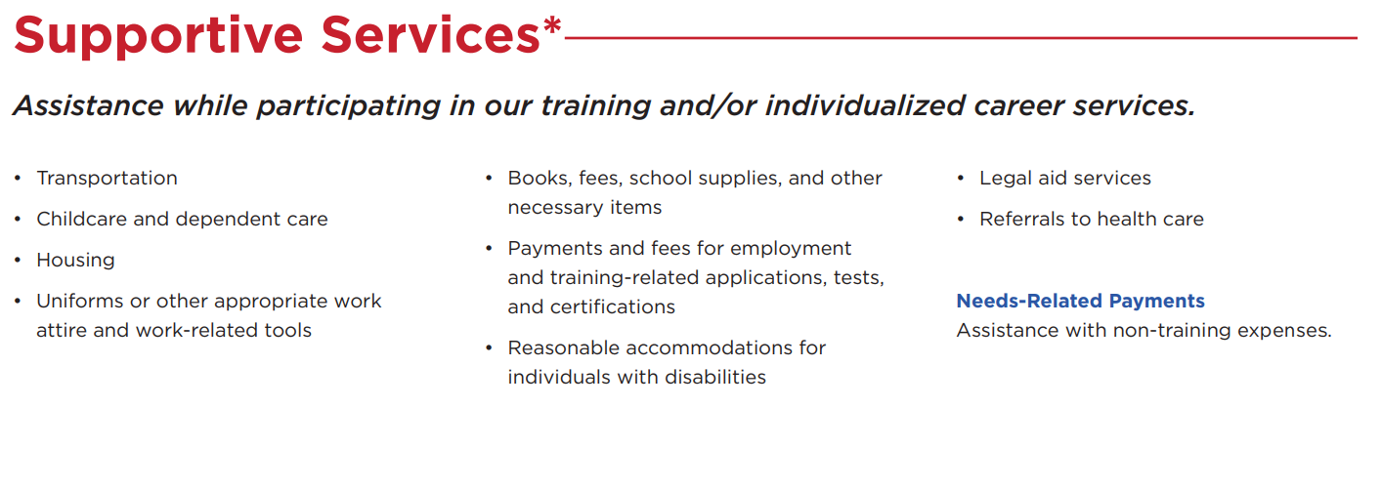

Slide 16
Employer services

Slide 18
We also help employers with their workforce needs, including hiring assistance, internships, and employee training.

Slide 19
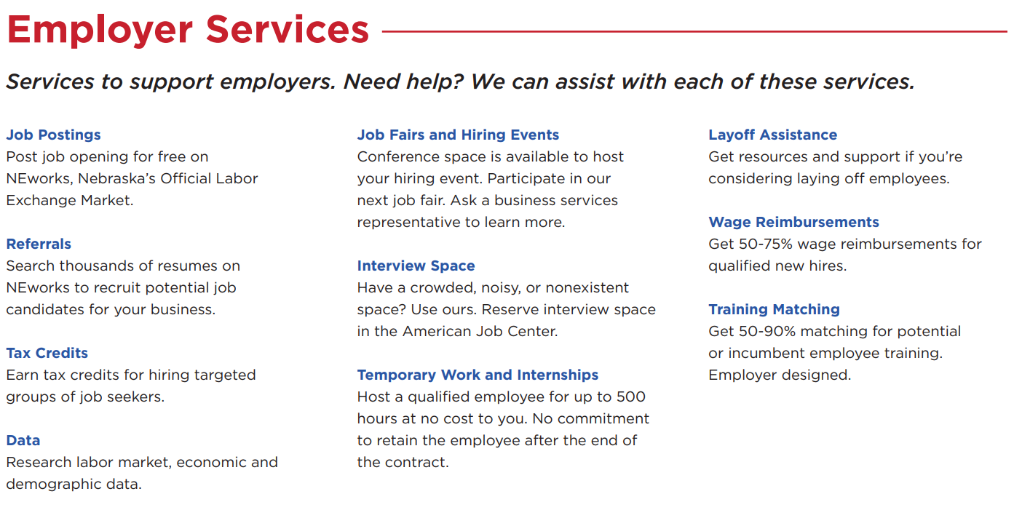

Slide 20
A modern center for today’s diverse needs

Slide 22
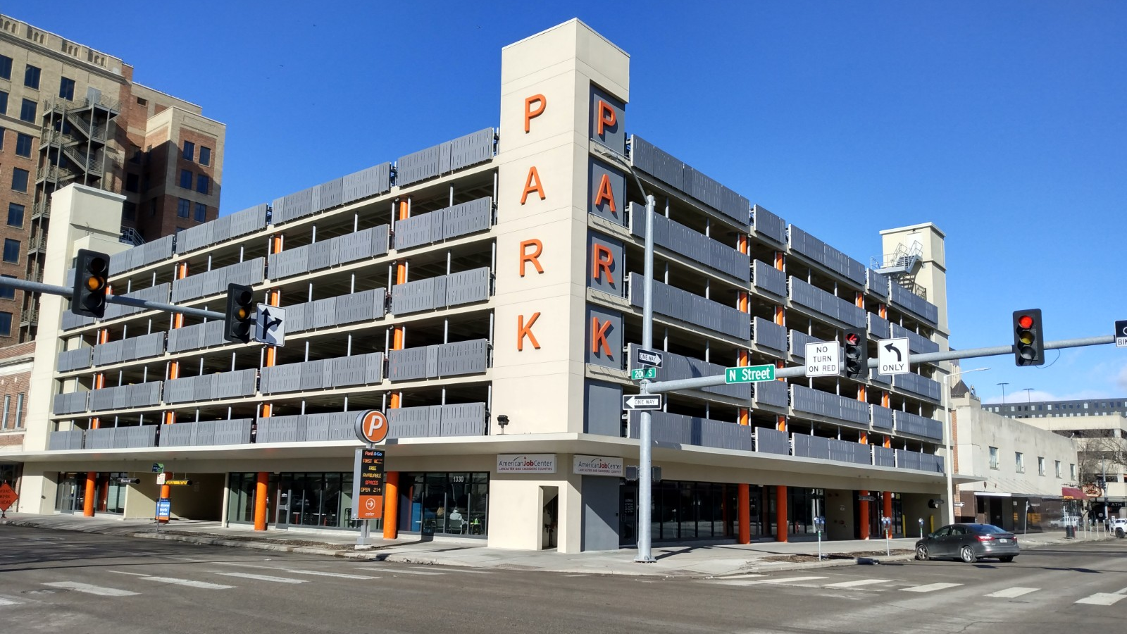
Open 7am-6pm Monday & Tuesday
8am-5pm Wednesday, Thursday, & Friday
1330 N Street, Suit A

Slide 23
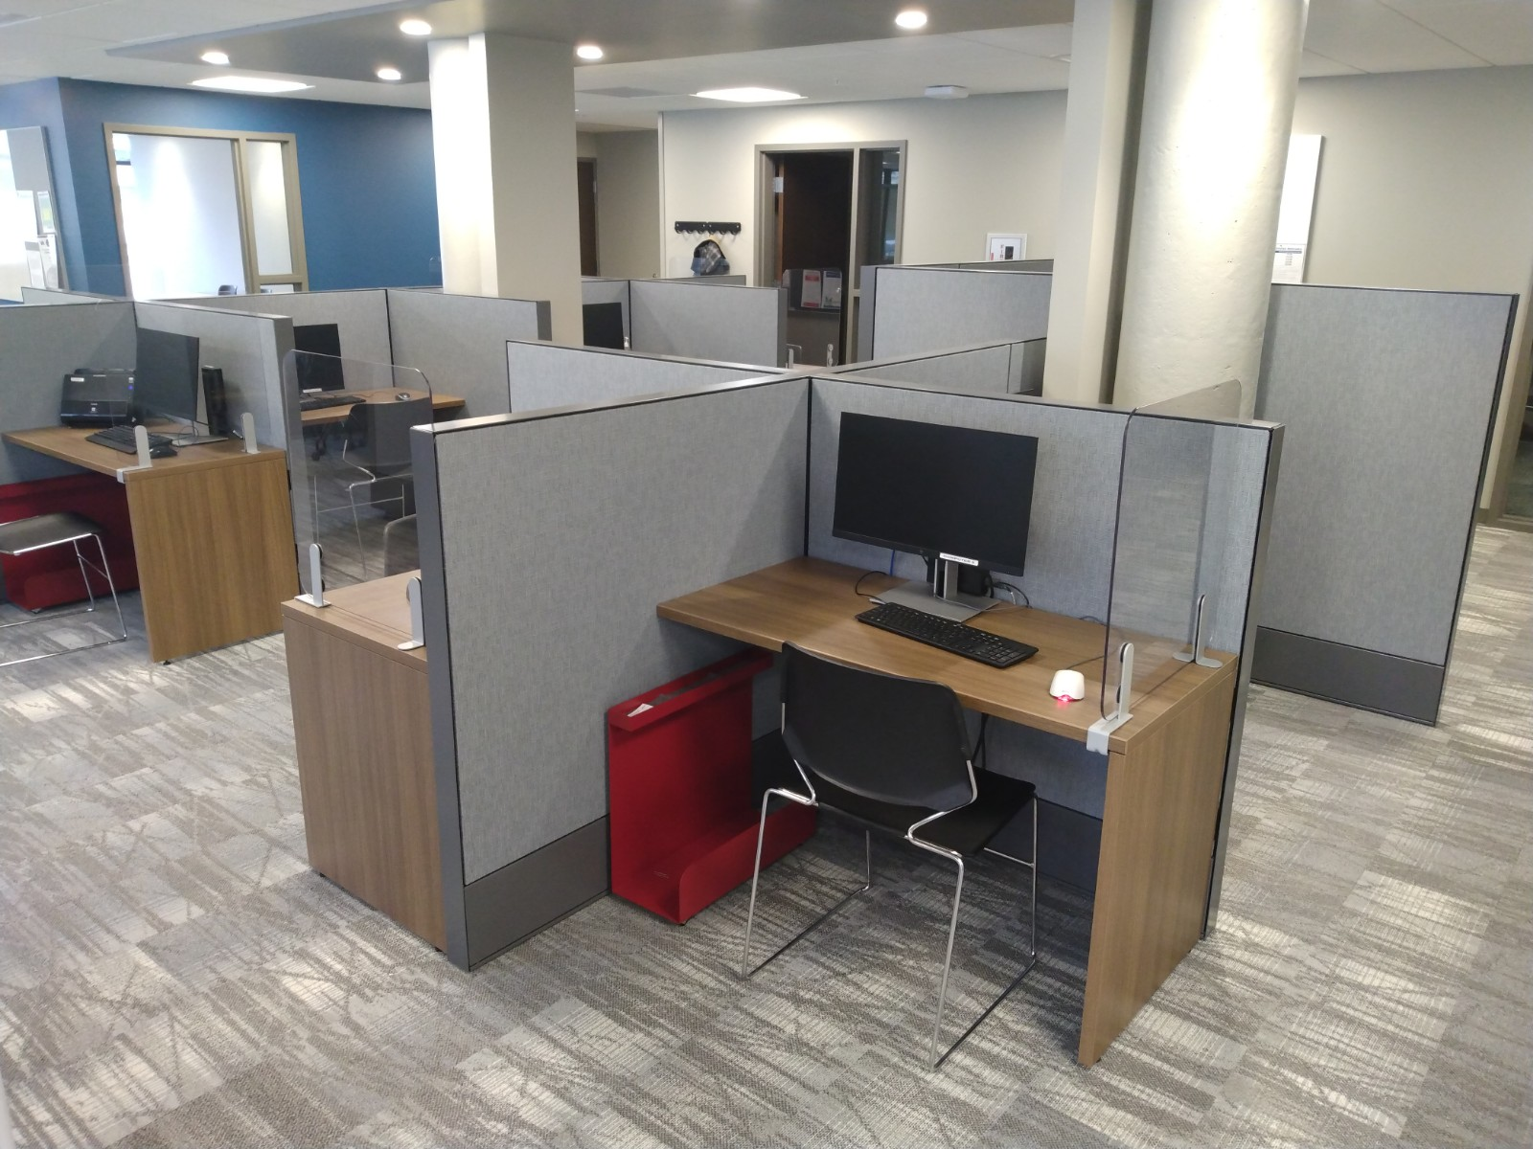
Assistive Technology
Our resource room is equipped with
An overhead projector that will magnify print materials
Zoom Text that will magnify websites
UbiDuo that allows deaf and hard of hearing jobseekers to interact with staff
Jaws software that will convert text to speech

Slide 24
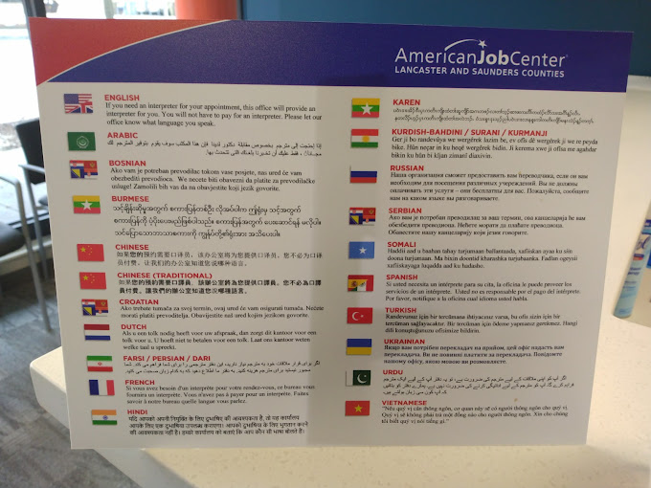
Language Access
Interpreter services are available to access all our services. Many documents are available in Spanish, Russian, Vietnamese, and Arabic.

Slide 25
Parking Validation Available
Parking validation is available to customers (both employers and job seekers) with an active NEworks account. To validate parking, sign in at the front desk and enter your validation code immediately into a pay station with your license plate number.

Slide 26
Our partners

Slide 27
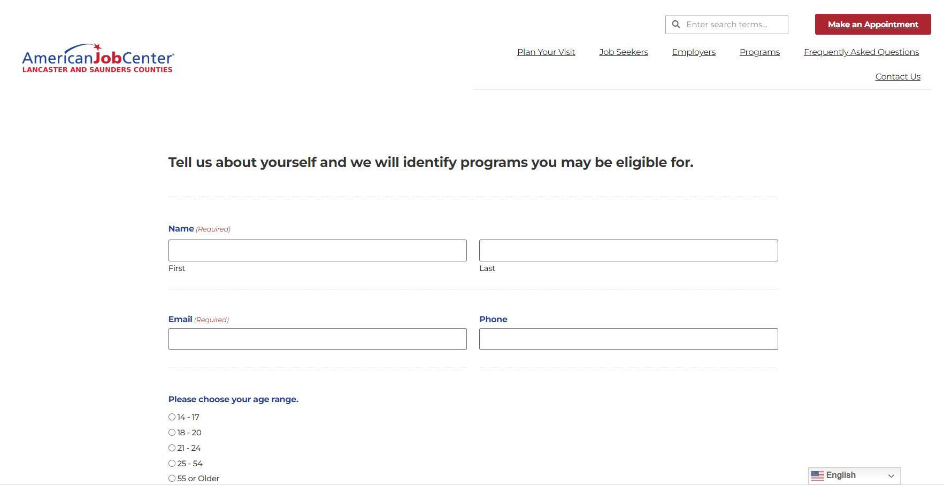
Our online program matcher

Slide 28
The American Job Center is publicly funded and administered by the City of Lincoln, in partnership with other government, industry, and non-profit groups. We coordinate services to over 20 work-related programs. The majority of our funding comes from the Workforce Innovation and Opportunity Act.

Slide 29
Get started by completing the program matcher online, making an appointment, or dropping by our N street location.
Learn more about the American Job Center at ajc.lincoln.ne.gov

