Slide 1
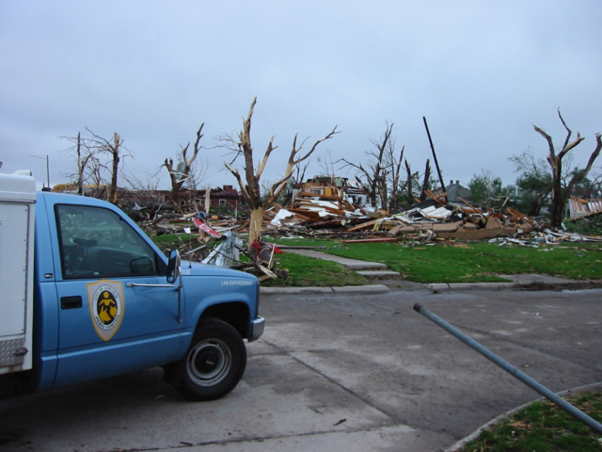
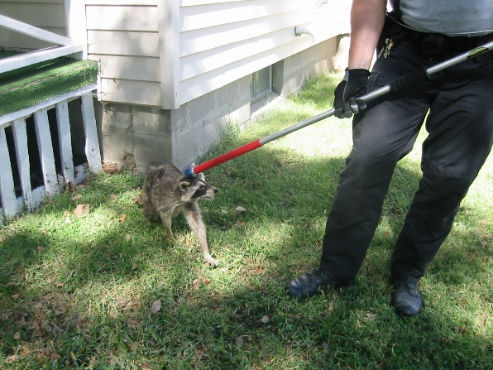
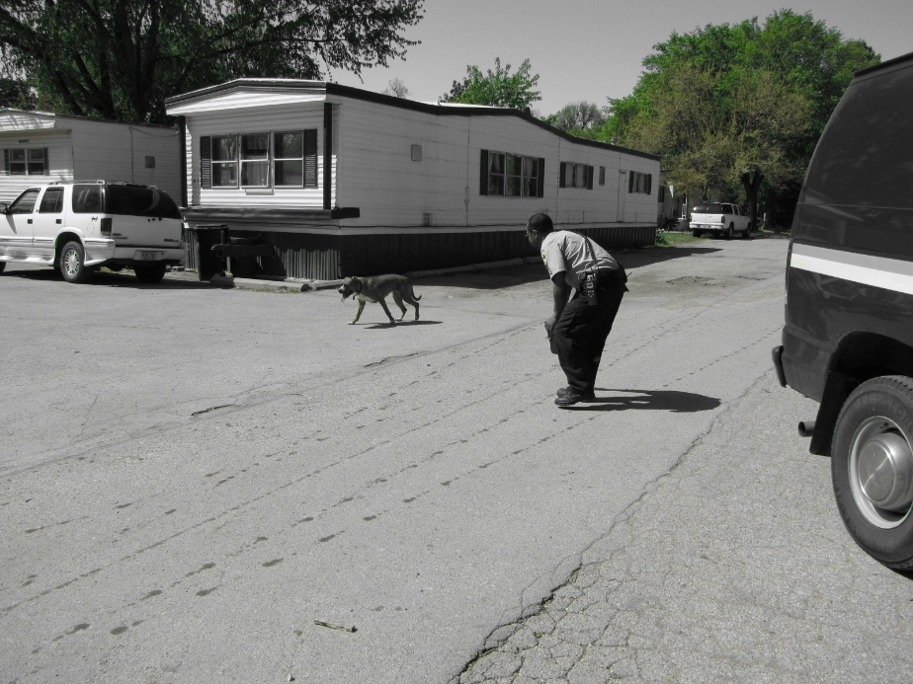
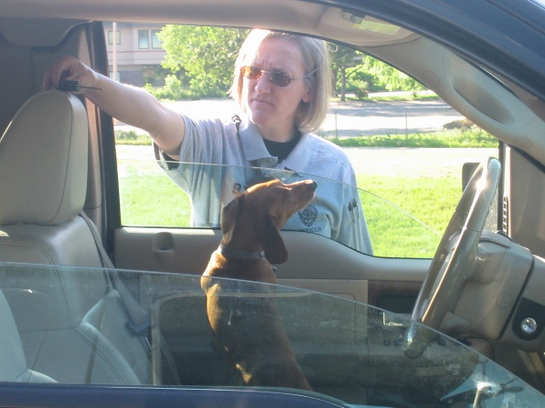
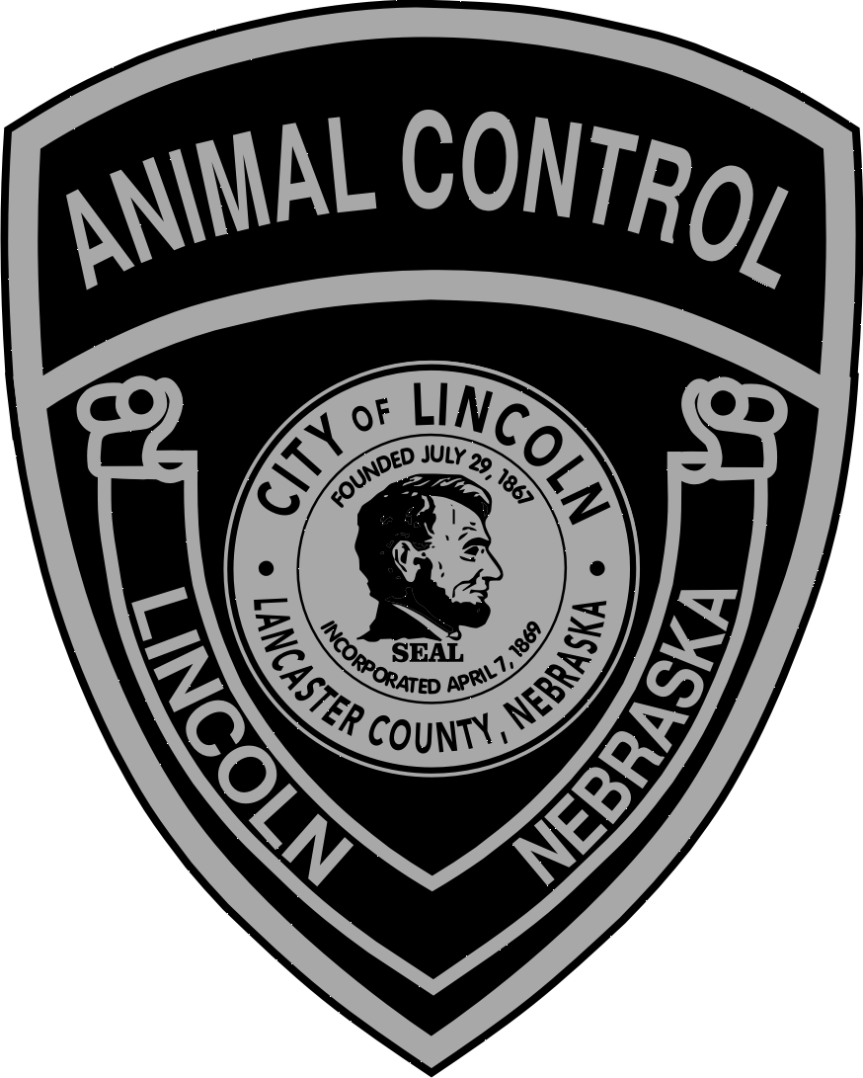
“Protecting People and Pets”
Lincoln Animal Control
Mayor’s Neighborhood Roundtable
August 8, 2022

Slide 2
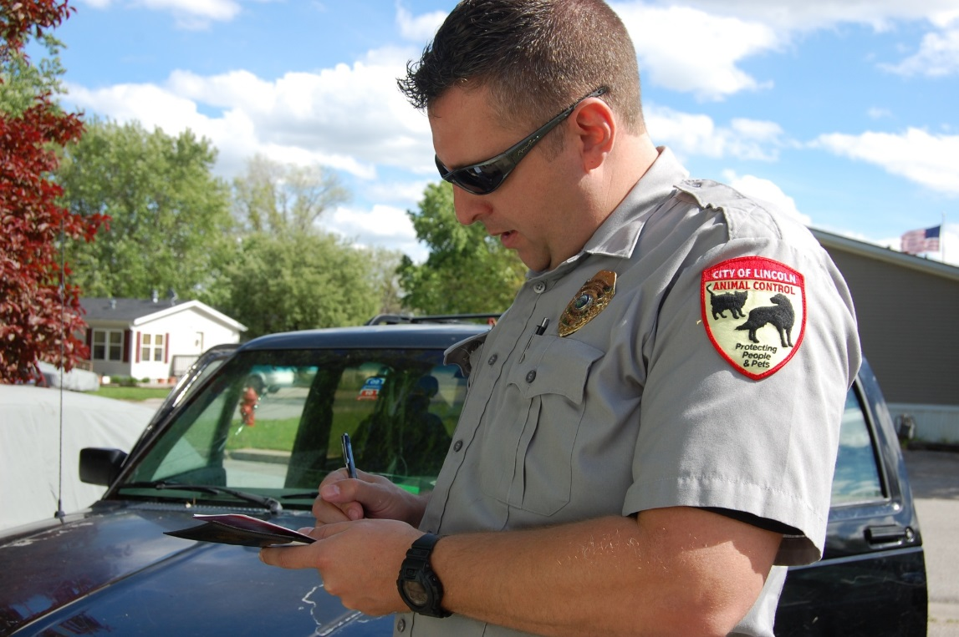
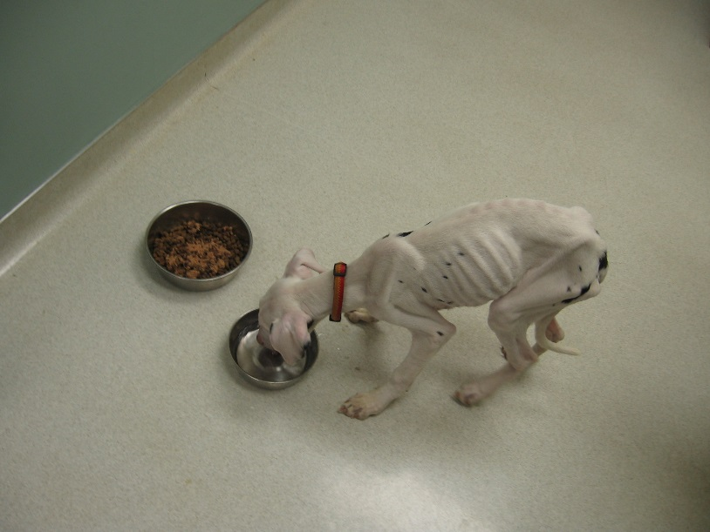
Animal Control Officers are Responsible for Enforcing State and Local Laws
Dog at large
Bites unlawful
Neglect and cruelty
Destruction of property
No license
No rabies vaccination
Leash law for dogs
Sanitation
Irresponsible owner
Barking dogs

Slide 3
Officer Service & Enforcement Calls
2021:
386 animal bites and 61 attacks.
477 neglect calls.
Responded to 746 wildlife calls. (bats, raccoons, opossums, and deer)
1,217 dead animal calls (domestic and wildlife).
31 coyote calls.
85 fox calls.

Slide 4
Officer Service & Enforcement Calls
2021:
106 dogs were declared potentially dangerous, dangerous, or vicious.
13,556 defect or warning tickets.
697 injured animal calls.
167 permits were issued for fowl/small and large animal, pet shops/groom shops/mobile groom shops, multi-cat household permits.
1,497 animals were impounded.

Slide 5
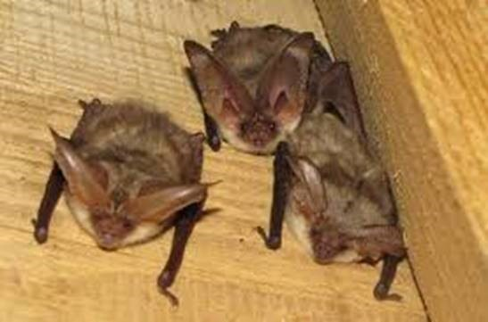
Connection between Public Health, People, and Animals
2021:
Animal Control received 1,015 bat calls in 2021.
345 bats were tested for rabies, 10 tested positive.
Prevention of animal bites (dogs, cats, and wildlife).
Sanitation/hoarding problems.

Slide 6
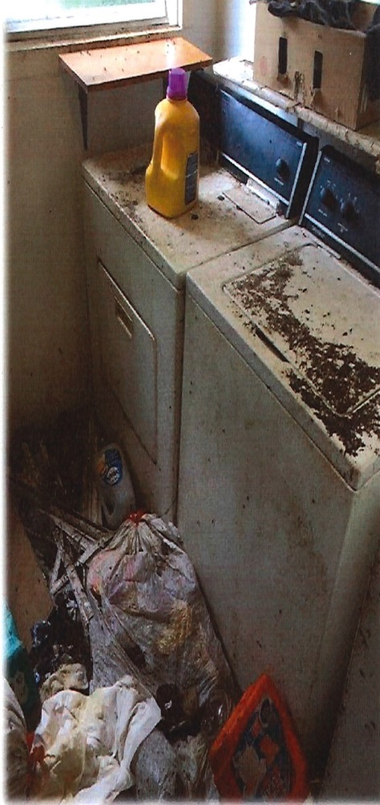
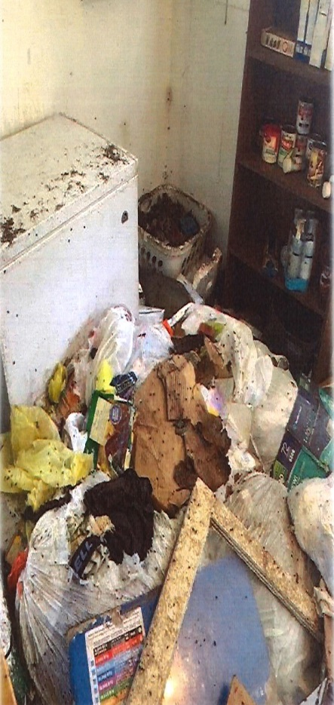
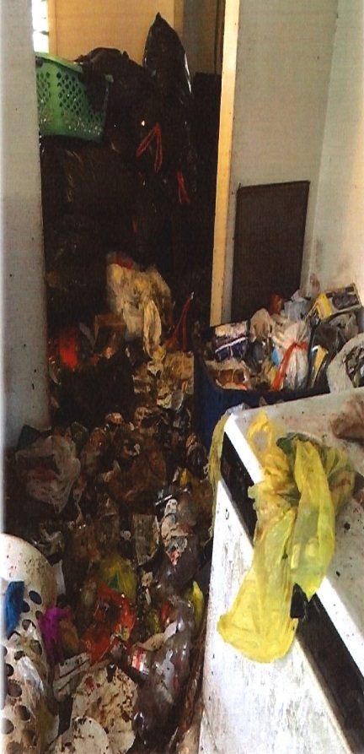
Sanitation Problems
L.M.C. 6.08.150 Sanitary Regulation
- “The owner shall remove waste
once every five days.”
L.M.C. 6.08.155 Disposal of Dog Waste
- “Dog feces must be disposed of in a
sanitary manner.”
Rental Properties vs. Private Home Owner

Slide 7
Abandonment of Pets/Animals
Officers must have court documentation or clearance from the Court Constable before entering any property
- Legal Eviction
Imminent Danger Established
- Outside vs. Inside
Animal owner leaves apartment and leaves an animal behind

Slide 8
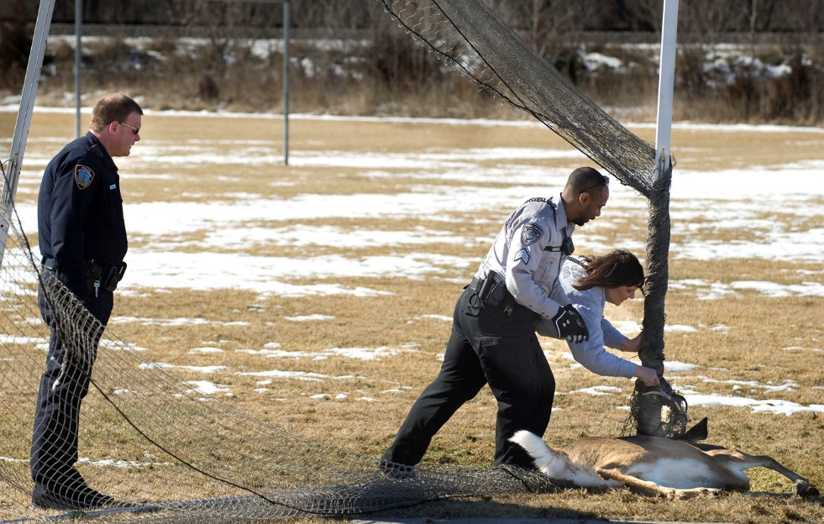
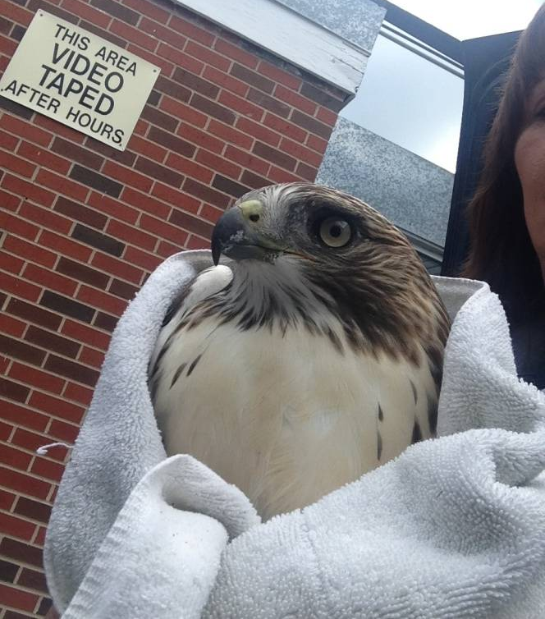
Responding to Diverse Community Needs
2021
Animal Control dispatchers received over 30,000 calls from the public.
Officers were dispatched on over 11,500 calls.
Last year, Lincoln pet owners licensed and vaccinated 64,229 dogs and cats.

Slide 9
How Decisions are Made and Vetted
Animal Control Ordinances and Policies
Animal Control ordinances (new and revised) have multiple levels of public input.
Health Director and staff
Animal Control Advisory Committee
Lincoln-Lancaster County Board of Health
City Attorney’s Office
Mayor’s Office
City Council (Public Hearings)
Public Hearings

Slide 10
Partnerships and Collaborations
Animal Control Advisory Committee
New and broader representation
Problem Resolution Team – Working to address problem properties
Lincoln Police Department Aging Partners
Building and Safety City Council
Urban Development Mayor’s Office
City Attorney’s Office Lancaster County Weed Control
Lincoln Housing Authority Lancaster County Sheriff’s Office County Attorney’s Office
Neighborhood Associations
Community Service Clubs

Slide 11
Partnerships and Collaborations
University of Nebraska – Lincoln, School of Veterinary Medicine and Biomedical Services; Rabies Testing and Consultation
Staff from the Capital Humane Society
Special interest and animal advocacy groups
- The Cat House, Feral Cat Agreement
- Lincoln Animal Ambassadors

Slide 12
Partnerships and Collaborations
University of Nebraska – Lincoln, School of Veterinary Medicine and Biomedical Services; Rabies Testing and Consultation
Lincoln Problem Resolution Team
Animal Control Advisory Committee
Capital Humane Society
Lincoln Animal Ambassadors
The Cat House
Animal rescue organizations

Slide 13
How We Are Funded
Approximately 70% fee funded
- Animal license sales
- Impound fees
- Permit fees
Approximately 30% city funded
- Capital Humane Society shelter services

Slide 14
Hours and Contact Information
Officers on Duty
Monday – Friday 7 am – 11:30 pm
Saturday – Sunday 8:30 am – 5 pm
May – September 11:30 pm – 7:00 am
Officers are on call for all other hours.
402.441.7900
lincoln.ne.gov (Keyword: Animal Control)
Visit us on Facebook

